Slide 1
Whatcha Gonna Do When They Come For You?
When Students and Employees Misuse Social Media

Slide 2
Topics Covered in this Section
Use of Technology/Social Media in the Classroom
Technology Use Policies
Authority to Discipline Students
Authority to Discipline Students for Online Conduct
  At School
  Away from School
Limitations on Discipline
  4th Amendment Limitations
  1st Amendment Limitations

Slide 3
Using Social Media in the Classroom

Slide 4
Using Social Media in the Classroom
Many districts are utilizing the internet and social media to enhance the educational and communicative functions of the districts. Examples include, but are not limited to:
  Emergency notification
  Notifying students, parents, public about events
  Notifying students and parents about classroom happenings, homework, resources, etc.
  Classroom blogs
  Virtual groups to work on projects or hold discussions
  Connecting to other classrooms at the school, in the country, from around he world

Slide 5
Using Social Media in the Classroom
  Make sure that you are aware of all social media accounts associated with your District
  Draft technology use policies and social media guidelines so that students, teachers, and stuff understand the parameters for appropriate and inappropriate use of social media and technology.
  Make sure that students, teachers, and staff are made aware of your technology use and social media policies.
  This IS the classroom, virtual or not, so supervision and possibly discipline must be present

Slide 6
Examples of Items to Include in a Technology Use Policy
The following is a non-exhaustive list of items that you may want to include in policies or agreements governing school sponsored technology resources (“school technology”):
School technology is only to be used for school-related purposes, and is not for personal use.
Users shall not use school technology in a way that disrupts the use of others or violates the code of conduct, school policies, local law, state law, or federal law.

Slide 7
Users are responsible for keeping their passwords/logins confidential. Users will be disciplined for using the passwords/logins of others, masquerading as others, or creating false accounts.
Profanity, vulgarity, obscenity, or language that is harassing, derogatory, or otherwise inappropriate for the school environment is not permitted.
Users shall not display, send, retrieve, or download any items that are sexually explicit, or contain hate-based or discriminatory material. Users shall notify a teacher or school administrator in the event inappropriate material is inadvertently accessed.

Slide 8
Users acknowledge that they have no right or expectation of privacy with respect to their use of school technology.
Users shall be courteous and respectful of others.
School administration and IT personnel have the right to access and monitor the activities and files of all users, at any time, and for any reason.
The use of school technology is a privilege and may be revoked at any time by school administration for violations of this policy or for engaging in any inappropriate use of school technology.

Slide 9
When Students Misuse Social Media…

Slide 10
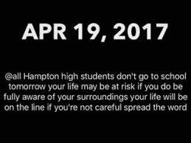
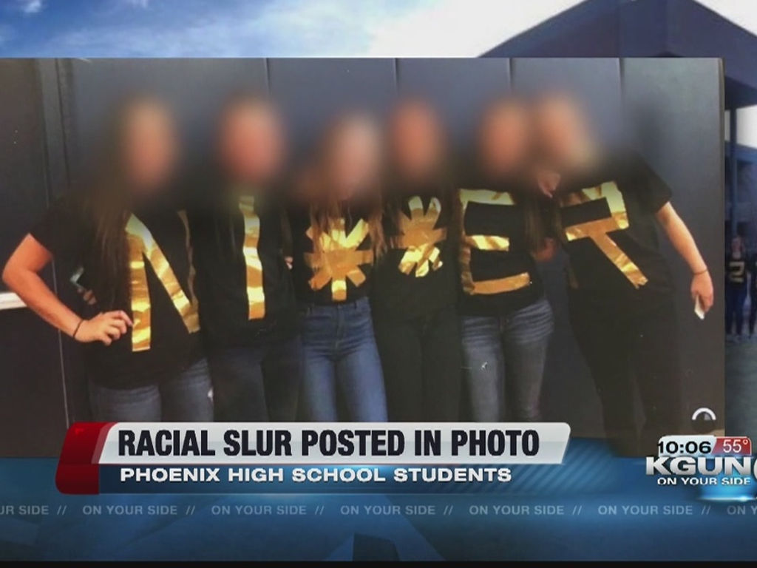

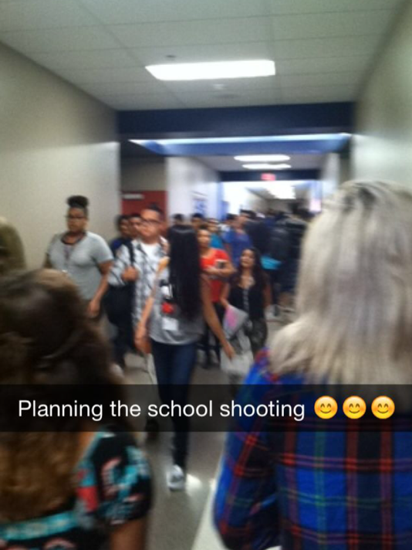

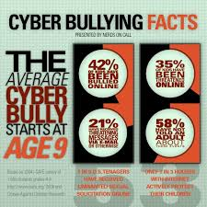
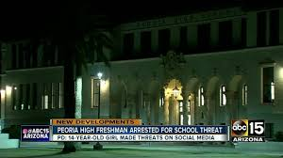

Slide 11
Authority to Discipline Students for Misconduct (On Campus):
The state and federal authority is very clear that schools are permitted and are obligated to regulate student misconduct that takes place on campus, to and from school, at school-sponsored events, and when conduct involves school property.
This includes any technology related/facilitated infraction that occurs on-campus or with school resources.
Make sure that your code of conduct is flexible enough to address the technological twist to your standard infractions.

Slide 12
Authority to Discipline for Off Campus Conduct (Generally)
Subject to certain limitations discussed next, there are circumstances when school authorities can discipline students for off-campus conduct.
In order to discipline students for misconduct that takes place away from school there must be some nexus between the misconduct and the educational environment in order to discipline a student for off-campus conduct.
Prior to initiating discipline, administration must be able to articulate how the student’s off-campus conduct caused a material disruption to the educational environment.

Slide 13
Examples of Student Misconduct/Abuse of Technology/Social Media
Specific Technology Use Infractions
  Attempting to access or download inappropriate sites or materials
  Attempting to hack School/District Systems
  Using another student’s login/password
  Using school technology for non-school purposes (if that is a condition of use)
  Engaging in Copyright/Trademark infractions
  Using devices during instructional time

Slide 14
Examples of Student Misconduct/Abuse of Technology/Social Media
Misconduct Facilitated by Technology
  Cheating/Plagiarism/Forgery
  Theft/Extortion
  Distribution of Alcohol or Drugs
  Bullying
  Intimidation
  Harassment/Sexual Harassment
  Discrimination
  Disruption to the Educational Environment
  Threatening and Educational Institution

Slide 15
4th Amendment Limitations Related to Student Use of Social Media

Slide 16
Basic 4th Amendment Principles
The 4th Amendment protects the public from arbitrary invasions of privacy by government officials and from “unreasonable searches and seizures.”
Public school employees are government officials!
You are government officials!

Slide 17
Lockers, Desks, and “School-Sponsored” Technology
In most circumstances, students have very little expectation of privacy in places owned by the school, such as in lockers, desks, etc..
This is especially true in circumstances where the schools put students on notice that the school retains ownership of the lockers or desks and may search the lockers at any time.
See Policy JIH- Student Interviews, Searches, and Arrests

Slide 18
School-Owned Technology
Similar to lockers and desks, students (and employees) have little expectation of privacy in “school-owned” technology equipment and services.
Again, this is especially true when students (and employees) have been put on notice that District and school officials reserve the right to monitor emails and any other activities using school sponsored technology equipment and services.
See also: Policies IJNDC (Use of Technology Resources) and JIH (Student Interviews, Searches, and Arrests)

Slide 19
Private Devices and Technology
Once we leave the realm of school-owned property and resources, there is a higher expectation of privacy, and school officials must follow the guidelines set in New Jersey v. T.L.O (1985)
The US Supreme Court held that the constitutionality of a search depends largely on:
  Whether or not the search was justified at its inception; and
  Whether or not the search itself is reasonable.

Slide 20
Is the Search Justified at its Inception?
The school official must have a reasonable suspicion that the particular student to be searched is violating a school rule or a local, state, or federal law and that a search will yield proof of the wrongdoing.
What is considered reasonable depends largely on the information upon which the school official relied upon to form the suspicion of wrongdoing.

Slide 21
Is the Search Itself Reasonable?
The search must be related in scope to the circumstances that prompted the reasonable suspicion of wrongdoing in the first place.
The search also may not be excessively intrusive in light of the age and sex of the student and the nature of the infraction.
The more intrusive the search… the better your justification for the search needs to be!

Slide 22

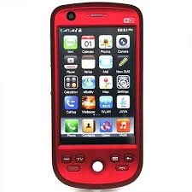
Cell Phones
Cell Phones, just like any other piece of student property, require REASONABLE SUSPICION to search.
Each element of a cell phone requires its own individualized suspicion.
  Text messages
  Call log
  Social media
  Voice messages
  Apps
Just because the search of one component is justified, does not mean that the search of another is.

Slide 23
Searching a Student’s Private Social Media Account
School officials may search, with little justification, public posts made by students and items that “friends” disclose to school officials.
School officials should avoid “hacking” into student’s social media accounts or posing as someone else to entrap students.

Slide 24
First Amendment Limitations Related to Student Use of Social Media

Slide 25
Limitation on Student Speech (Generally)
First Amendment to the U.S. Constitution:
  Congress shall make no law …abridging the freedom of speech, ...
Because school districts are a public entities, districts must be careful when they attempt to regulate the speech of their students, staff, and patrons.
Students retain their First Amendment Rights when they are at school, but this right is neither absolute nor limitless.

Slide 26
Limitation on Student Speech (Generally)
Landmark U.S. Supreme Court Case Tinker v. Des Moines, 393 U.S. 503 (1969).
Generally, school administrators cannot discipline students for the content of their speech unless Content is:
  Obscene, lewd, or plainly offensive:
  Promotes illegal activity,
  Creates a material disruption to the school environment
These principles apply to school-sponsored technology and a student’s use of these resources to express themselves.

Slide 27
Limitations on Off Campus Speech
When schools attempt to punish a student for his/her off campus expression, they must carefully consider an analysis of the student’s First Amendment rights to free expression.
When off-campus expression is merely offensive or obscene, the school will not have the authority to discipline the student.
Schools officials must be able to articulate the nexus between the off-campus expression and a material disruption of the school environment.

Slide 28

What Do You Think?
Student creates a website at home and without the use of school resources.
Website is highly critical of principal and teachers and used vulgar language to communicate his feelings.
Website has a link to the school website and invites other to contact the principal and express their opinions about the school.
Student’s friend, Amanda, sees the webpage while she is using Student’s home computer.

Slide 29
What Do You Think?
Later, Amanda wants to get back at the student after a fight and shows the webpage to a teacher, who shows the webpage to the principal.
The teacher lets four other students see the page.
The principal is upset about the way he is made fun of on the website and that the website found its way into the classroom.
The principal suspends the student for ten days. Do you agree?

Slide 30
Beussink v. Woodland R-IV Sch. Dist., 30 F. Supp. 2d 1175 (E.D. Mo. 1998)
The court found that the suspension violated the student’s First Amendment rights.
While the principal had been offended by the content of the speech, the court found that “[d]isliking or being upset by the content of a student’s speech is not an acceptable justification for limiting student speech” or for disciplining the student for expression that occurred outside of school.

Slide 31
What Do You Think?
Student creates a website at home and without the use of school resources that makes fun of teachers and administrators.
Prior to accessing the website you have to agree that you are not a teacher/administrator, that you won’t disclose the identity of the creator, and that you won’t cause trouble for the creator.
Website entitled “Welcome to Mrs. Fulmer Sux”
Website lists reasons why “Mrs. Fulmer should be fired”
  She shows off her fat f***ing legs.
  The fat F*** smokes.
  She’s a bit**!

Slide 32
What Do You Think?
Website goes to state “Why Mrs. Fulmer Should Die” – check out my diagram.
Website solicits $20.00 donations to hire a hitman.
Website has picture of Mrs. Fulmer’s severed head with blood dripping off her neck.
Shows Mrs. Fulmer’s face morphing into Hitler’s face.
Has “F*** you Mrs. Fulmer. You are a Bit**. You are a stupid bit**! (136 times)
Would you discipline for this? Why? Why not?

Slide 33
See J.S. v. Bethlehem Area Sch. Dist., 757 A.2d 412 (Pa. Commw. Ct. 2000).
The court upheld the decision of the school to expel the student due to the material disruption caused by the website.
The Court stated that “[r]egrettably, in this day and age where school violence is becoming more commonplace, school officials are justified in taking very seriously threats against faculty and other students.”

Slide 34
See J.S. v. Bethlehem Area Sch. Dist., 757 A.2d 412 (Pa. Commw. Ct. 2000).
The District was able to show a material disruption to the school environment:
  The teacher ultimately had to go on leave due to anxiety and other medical issues as the result of this incident.
  Due to the teacher’s absence, the District had to hire a number of substitutes, which resulted in a disruption to the educational process for the students in the teacher’s class.
  The administration also gave testimony how this incident affected the morale of the school.
  Similar case at: Wisniewski v. Weedport Central School District (2nd Cir. App. 2007)

Slide 35
Other Examples Where Student Discipline for Misuse of Social Media Was Upheld
Kowalski v. Berkeley County Schools (4th Cir. Ct. App)(2011)
12th grader created and posted a webpage, while at home, to MySpace that was largely dedicated to ridiculing a fellow student.
COURT: The Court upheld a 5 day suspension.
“Kowalski indeed pushed her computer keys at home, but she knew that the electronic response would be pos…published beyond her home and could reasonably be expected to reach the school or impact the school environment.
The court went on to reason that Kowalski “used the internet to orchestrate a targeted attack on a classmate and did so in a manner that was sufficiently connected to the school environment as to implicate the District’s authority discipline speech [that disrupts the school environment or collides with the rights of others]

Slide 36
Other Examples Where Student Discipline for Misuse of Social Media Was Upheld
Wynar v. Douglas County School District (9th Cir. Ct. App. 2013)
10th grade student was expelled for sending violent and threatening off-campus instant messages to his friends about his desire to shoot up the school.
He wrote frequently about weapons, going shooting, WWII, and was shown to have weapons in the house.
His friends were alarmed and told the football coach, who told the principal.
COURT: Upheld the expulsion because: a) The student was sending messages to other students; b) it was reasonably forseeable that the messages would reache the campus.

Slide 37
Employee Misuse of Social Media

Slide 38
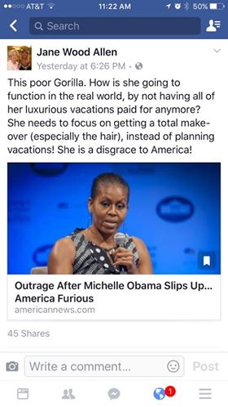
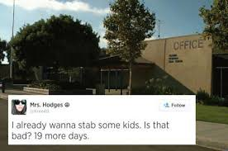

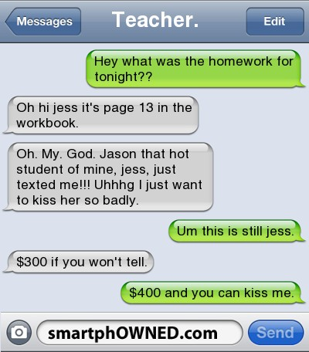
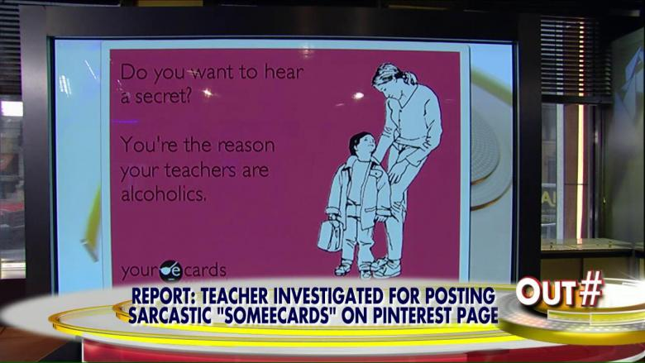

Slide 39
Topics Covered in this Section
Authority to Discipline Employees
Technology Use Policies
Authority to Discipline Employees for Online Conduct
  At the Work Place
  Away from the Work Place
Limitations on Discipline
  4th Amendment Limitations
  1st Amendment Limitations

Slide 40
Employee Discipline –
On Campus
Schools have the authority to discipline employees for violations of work-place policies.
Schools also have the authority to discipline employees for the inappropriate use of school resources, e.g., school provided:
  Cell phones
  Laptops and computers
  Internet and E-mail

Slide 41
Employee Use of School Resources
In addition to the items listed in technology use policies for students, policies should also include the following for employees:
  Employees shall not use school technology for personal, non-school related business.
  Employees shall not use school technology for political activities or to effect the outcome of elections.

Slide 42
Employee Discipline for Online Conduct
Like a student’s online conduct, an employee’s online conduct can result in discipline if the conduct disrupts the school environment and, consequently, the teacher’s ability to perform his or her job effectively.
Clearly, criminal conduct such as child pornography or soliciting sex from a minor will result in disciplinary action in addition to criminal prosecution
An employees online conduct may also result in discipline if the conduct violates Board Policies or Regulations.

Slide 43
Employee Discipline for Off-Duty Conduct - Online Conduct
Examples of online conduct that could result in discipline for violating Board policies:
  Inappropriate use of school technology and resources
  Lying about being sick or injured
  Disclosure of confidential student information
  Harassing another employee based on a protected characteristic
  Bullying other employees
  Inappropriate use of district tradenames or trademarks
  Inappropriate relationships with students
    Grooming behavior
    Peer-like interactions with students

Slide 44
4th Amendment Limitations Related to Employee Use of Social Media

Slide 45
School District’s as a Governmental Employer
Generally, a search of an employee’s workspace and emails:
  Must be limited in scope and based on reasonable suspicion or legitimate business need; and
  Must outweigh the employee’s reasonable expectation of privacy
  [We don’t typically search employees personal belongings or homes, and so those searches are best left to the police]

Slide 46
1st Amendment Limitations Related to Employee Use of Social Media

Slide 47
Employee Discipline for Off-Duty Conduct - Online Conduct
Generally speaking, school employees have a degree of protection in their speech, so long as employees are speaking as citizens about matters of public concern. See Garcetti v. Ceballos, 547 U.S. 410, 411 (2006); see also Pickering v. Bd. of Ed., 391 U.S. 563, 568 (1968).
Discipline for a teacher’s online conduct can have many considerations:
  Whether there is a nexus between the online conduct and the teacher’s employment,
  whether the conduct violates any school policies,
  Whether or not the conduct violates any state or federal laws.
  Whether or not the conduct impedes the teacher’s ability to do their job
  Whether or not the conduct causes a disruption to the work place

Slide 48
What Do You Think?
Teacher opens a MySpace account to communicate with students about homework, and to communicate with students in a non-school forum to learn about his students and relate to them better.
The administration, the teacher’s colleagues, and some students raised concerns about the page because there were pictures of naked men and inappropriate comments next to some of the students’ pictures.
There were also concerns about the casual dialogue between the teacher and his students.

Slide 49
What Do You Think?
The teacher removed his MySpace profile at the urging of Administration and his colleagues; however, he then opened a new account and directed his students there.
Both accounts contained dialogue with students, dialogue with other non-student MySpace users, pictures, blogs, and poetry samples.
One poem addressed the teacher’s opposition to the war in Iraq.

Slide 50
What Do You Think?
Consider the following dialogue:
Byczko: “yo, hows it going sir? i figured i would leave a comment because i'm bored:)”
[Teacher]: “Things are going well for me. Sorry that you are bored. I'll see you tomorrow. If you ever call me sir again, you will be serving a detention sooooo long that your great grandchildren will have to finish it out. LOL”
Byczko: “hey, i think thats a threat, u and me might have to fight!!! SIR!!! lol, see ya tomorrow!”
[Teacher]: “I would never threaten you. It's a straight out promise. I'll give you a choice you can serve detention until you've copied every page of every book in my room or you can stay from tomorrow until 11-22-3088”

Slide 51
What Do You Think?
Or this:
[Teacher]: “Repko and Ashley sittin in a tree.
K I S S I N G. 1st comes love then comes marriage. HA HA HA HA HA HA HA!!!!!!!!!!!!!!!!!!!!!!!! LOL [Laughing Out Loud]”
repko: “dont be jealous cuase you cant get any lol:)”
[Teacher]: “What makes you think I want any? I'm not jealous. I just like to have fun and goof on you guys. If you don't like it. Kiss my brass! LMAO [Laughing My Ass Off]”

Slide 52
What Do You Think?
The teacher’s contract was not renewed.
The teacher sued the District alleging that the district violated his First Amendment Rights when because of his use of his MySpace account to interact with students and because of his opposition to the Iraq war.
Do you agree with the district or the teacher?

Slide 53
See Spanierman v. Hughes, 576 F. Supp.2d 292, 312 (D. Conn. 2008)
The Court decided that Mr. Spanierman’s dialogue with his students, in addition to being seemingly unprofessional, did not constitute speech that addressed a “public concern.”
Because this speech was not protected under the First Amendment, Mr. Spanierman could be non-renewed based on this speech.
The Court did not find any indication that Mr. Spanierman was disciplined for his opposition to the war.
Notes:
Mr. Spanierman also raised a number of other issues that are outside the scope of this article, including due process claims, equal protection claims, selective prosecution, and First Amendment claims regarding freedom of association. He was ultimately unsuccessful on all counts.

Slide 54
Other Examples Where Courts Found in Favor of the District/Employer
Munroe v. Central Bucks School District (3d Cir. 2015)
Court upheld the decision of a school district to terminate a teacher after she posted some blogs entitled “Where Are We Going and Why Are We in This Handbasket.”
In her posts, the teacher commented that her students were “lazy assholes” and that they “dress like a street walker.”
The teacher’s blog was discovered by students and caused many students and teachers to be upset.

Slide 55
Other Examples Where Courts Found in Favor of the District/Employer
Similar case: In Re: Jennifer O’Brien (NJ 2011)
While the First Amendment protections do not generally rise and fall on public reactions, or on whether the words used were offensive, on a public education setting thoughtless words can destroy the partnership between home and school that is essential to the mission of the schools.
Our courts have recognized that “a public employer may, consistently with the First Amendment, prohibit its employees from being ‘rude to customers.”

Slide 56

____________________
Udall Shumway plc
1138 North Alma School Road, Suite 101
Mesa, Arizona 85201
Jessica Sanchez
jss@udallshumway.com | 480-461-5374
www.udallshumway.com
Candyce Pardee
cbp@udallshumway.com | 520-678-3108
3555 E. Fry Blvd. Sierra Vista, AZ 85615

